Slide 1
Child Care for Families Experiencing Homelessness: Three Case Studies
Lisa Berglund
University of Maryland, School of Public Policy

Slide 2
Early Head Start- Child Care Partnership Grants
$500 million awarded in 2015
Blends Early Head Start with private child care providers
Providers served families receiving assistance through the Child Care and Development Block Grant (CCDBG)
  Specifically, how did they serve families experiencing homelessness?
Notes:
$500 million in 2015 (FY2014), $635 in FY2016
In first year, partnered with over 1200 local child care centers and 600 family child care programs, serving 32k infants and toddlers
Homeless not specifically the point of this grant, but these programs spoke to this population

Slide 3



Homelessness and children
Defining homelessness
Harms for infants and toddlers:
  Brain development
  Emotional development
  Health concerns
Notes:
Defining homelessness: multiple definitions through HUD, Dept. of Ed, and McKinney-Vento, but generally a person living somewhere that is not designed to be a residence.
Brain development: Between birth and age two, a human brain more than triples in size, reaching 75% of its total adult size at the end of the second year of life. Traumatic environment such as homeless children face can negatively impact brain growth. In one study, 15% homeless children were found to have a development delay and 9% had two or more.
Emotional development: Infants- primary task is to establish security and trust; toddlers- self-regulation and identity. Variable/uncomfortable environments prevent security; no room to explore. Higher mental health problems with low-income children, and one study found 54% of homeless children with evidence of developmental delay.
Health: health issues researchers have found that homeless infants and toddlers face at higher rates than housed children: preterm birth, low birth weight, Neonatal Intensive Care Unit stays, chronic ear infections, lead toxicity, asthma, and higher infant/child mortality.
Scope: In 2015, 22.6% of the homeless population, or about 127,787 people, were children under the age of 18. Over half the children who lived in federally funded homeless shelters are under the age of 5. About one Maryland football stadium
It’s concerning the challenges these children face, but quality child care has shown to help mitigate these harms on children, and then also allow parents the freedom to search for jobs or complete training to put their families back on the path to being financially stable.

Slide 4
Methodology
Research questions:
  Were EHS-CCP grant recipients who mentioned serving homeless able to do so?
  What were their challenges? Successes?
Case studies: Indiana, North Carolina, Maryland
Data collection
  Interviews
  Document reviews
  Program data
  Observation
Notes:
Research questions:
Were EHS-CCP grant recipients who mentioned serving homeless able to do so?
What were their challenges? Success?
Case studies: Elkhart & St. Joseph Counties Head Start Consortium in Indiana, Telamon in NC, Maryland Family Network. Diverse in geography, size, grant award, experience with EHS.
Data collection
Interviews: Interviews with administrators familiar with grant proposal process and partnerships
Document reviews: grant proposals, websites, additional documents from administrators
Program data- PIR
Observation- will talk about in a minute

Slide 5
Findings
Head Start Consortium
Indiana
Telamon
North Carolina
Maryland Family Network
Maryland
Geography
Rural
-
Midwest U.S.
Chatham County: rural;
Urban
–
Mid-Atlantic U.S.
Wake County: urban
–
Southern U.S.
Size of sponsoring
1,080
children
through
4,941
children in six
533
children
though
program
(2014
)
center
-
based
programs
states through 58 centers
center
-
based and home
and home
-
based
visit programs
programs
Size and type of EHS
-
CCP
Expansion & expansion
Expansion partnership:
Expansion:
program
partnership: EHS
EHS expansion for 112
EHS expansion for 107
Expansion for 100
children at seven centers
children; 83 at existing
children and CCP for 16
operated by child care
centers and 24 at a new
children
partners
center
Grant awarded
$2,100,000
$1,700,000
$1,500,000
4 years as a Head
25 years as an EHS
20+ years as an EHS
Previous history with
Start/EHS provider
provider
provider; 69 years as an
EHS
early childhood
education advocate

Slide 6
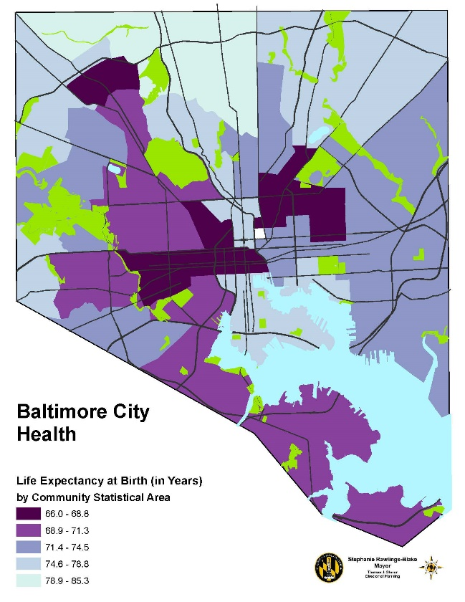
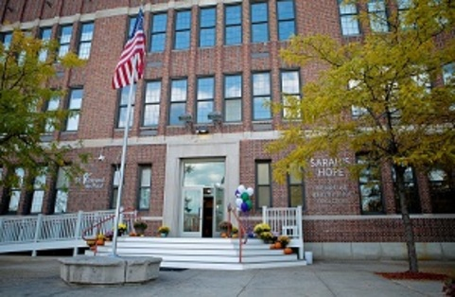
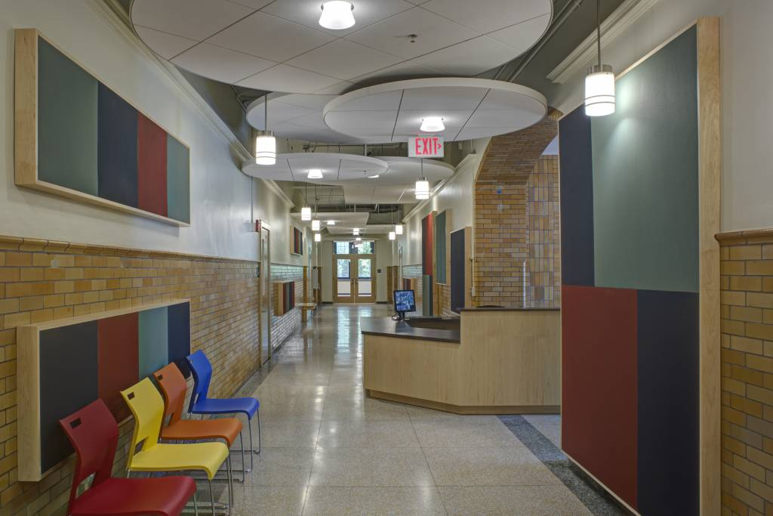
Findings: Sarah’s Hope
Notes:
Observation and meeting at Sarah’s Hope
One of the highest poverty areas in Baltimore—domestic violence is 25% higher than the rest of the city, teen birth rate is twice the state average, and one out of every five children is arrested before they turn 18
Description of facilities and nursery run by PACT
Spoke with director of the nursery there, and also observed the children and parents in segments of 5 to 20 minutes, echoing the Child-Caregiver Observation System used in an earlier study of EHS in 1998

Slide 7
Analysis: Homeless Enrollment
 | Homeless children served | Homeless families served | Total families served | % of families served who were homeless
Head Start Consortium | 3 | 3 | 152 | 2%
Telamon | 47 | 37 | 101 | 37%
Maryland Family Network | 73 | 61 | 99 | 62%
Notes:
- After collecting all my data through interviews, observations, document reviews, and data analysis, I went to answer our original research questions. The first was—were these child care centers able to serve homeless children with the EHS-CCP grant?

Slide 8
Child social/
Recruitment/
Parent social
Parent
-
child
Housing
Community
emotional
services
Transportation
prioritization
relationships
assistance
partnerships
services
of homeless
Elkhart & St. Joseph Counties Head Start Consortium
Weak
Moderate
Moderate
Strong
Weak
Weak
Strong
Telamon
Moderate
Strong
Moderate
Weak
Moderate
Moderate
Strong
Maryland Family Network
Strong
Strong
Strong
Moderate
Moderate
Strong
Strong
Analysis: Homeless services
Notes:
After gathering data, I evaluated several categories that continued to surface in interviews as important components in services for homeless families, and then rated each grant recipient on the strength of their program.
Child social/emotional
Elkhart: Served so few, nothing specific
Telamon: spoke about health services, and some emotional but wasn’t specific program for homeless
MFN: Child feeling mad example, separation anxiety songs and practices
Parent social
Elkhart: support for teen moms, strong partnerships for social services
Telamon: “family partnership process” intake interviews, setting goals, financial training
MFN: mindfulness, gaining trust, coffee example
Parent-child relationships
Telamon and the Consortium only spoke somewhat about enhancing parent-child relationships
MFN: Mindful Awareness Play with parents, sharing “angel moments” with parents
Transportation
Indiana: strongest. Homeless families: mobile, rural area. Paid for bus services for families
MFN: paid for some cabs but not other transportation
Telamon: #1 barrier, no transportation, liability, child care centers not in highest need areas either
Housing assistance
Indiana: housing transition=biggest challenge
Telamon: end goal of housing not quite achieved
MFN: Homeless shelter staff assist families and other partners across state too, but nothing that MFN does
Recruitment/Prioritization of homeless
Indiana: Low #s, but had hard time saving spots based on timing. New 3% policy will help
Telamon: some advertising and prioritized points, but more word of mouth
MFN: Not much active outreach across the state, but strong priority because of partnership with Sarah’s Hope
Community partnerships
Indiana: Very strong community partnerships, which was good with a program that was weaker. Centrally located in South Bend (good and bad)
Telamon: “resource rich,” Project CATCH referrals
MFN: One struggle: CCPs—not prepared for EHS standards; but PACT partnership and shelter partnership very strong

Slide 9
Analysis: Challenges & successes
Challenges
Successes
Mobile population
Sustaining long-term partnerships
Addressing trauma
Creating financial and housing stability
Finding a strong child care partner
Serving additional homeless families
Notes:
Based on this data and these interviews, there were also a few core challenges and successes I found at the child care centers in these case studies.

Slide 10
Recommendations: Challenges & successes
Challenges
Successes
Mobile population
  Provide transportation
Sustaining long-term partnerships
  Transition coordinators
  Better partnership vetting
Addressing trauma
  Staff training
Creating financial and housing stability
  Strong partnerships with HUD
  Financial training for parents
Finding a strong child care partner
  Strong CCP and community partners
Serving additional homeless families
  3% policy
  More partnerships like Sarah’s Hope
Notes:
Based on this data and these interviews, there were also a few core challenges and successes I found at the child care centers in these case studies.

Slide 11

Next steps
Additional funding and research
A focus on the people and partnerships, not just policies
Notes:
Additional funding/research
Demonstration grant, grant specific for homeless families in EHS/EHS-CCP, or just more EHS-CCP grants in general
Conclusion: I learned a lot about the challenges homeless children and families face, and what child care centers across the country are trying to do about it. But as important as the EHS requirements and guidelines are, it seemed the biggest services for homeless families came through the people who staffed the individual centers, and the partnerships they made in their local communities to create that continuum of care. I hope that some of my findings are able to help ACF and future child care partners to come. Thank you.

Slide 12
Questions?
Lisa Berglund
lisadberglund@gmail.com

